Slide 1
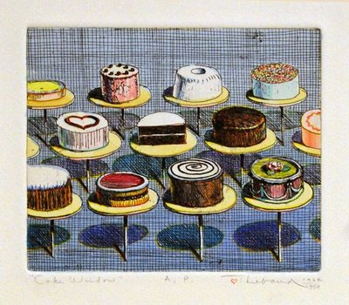
Wayne Thiebaud
Delicious Desserts

Slide 2
Who is Wayne Thiebaud?
Wayne Thiebaud is a famous artist that did most of his artwork during the 1950’s and the 1960’s.
Thiebaud is mainly a painter and printmaker.
Wayne is best known for his artworks that depict cakes, pies, ice cream, and other desserts.
Thiebaud is considered a Pop artist.

Slide 3
What is Pop Art?
Pop Art is an art movement that began in the 1960’s.
The “pop” in Pop Art is short for popular.
During this art movement, artist created artwork showing everyday items that people knew, like food, famous people, and other objects.
Some famous Pop artists not only include Wayne Thiebaud, but also Andy Warhol, Roy Lichtenstein, and Jasper Johns.

Slide 4
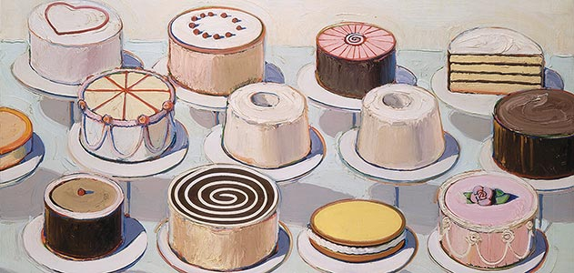
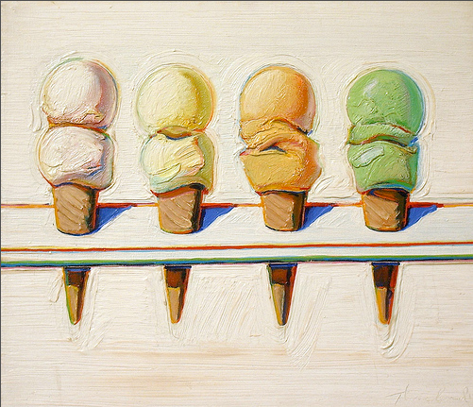
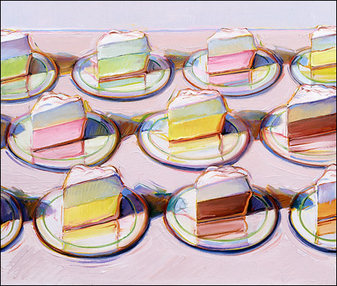
What types of colors are used by Thiebaud?
Are the colors used in these artworks realistic?
Are the colors used in these works bright or do the colors seem mixed with white?

Slide 5
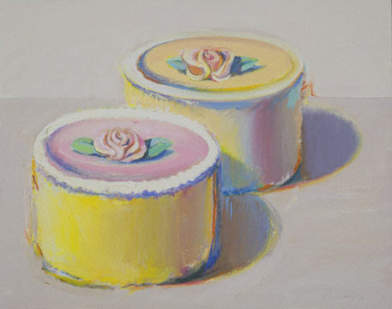
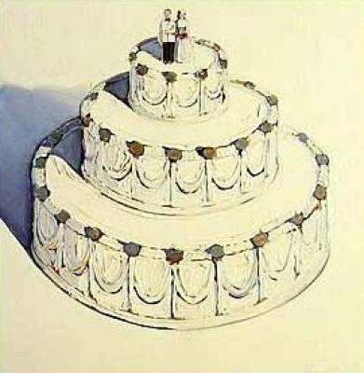
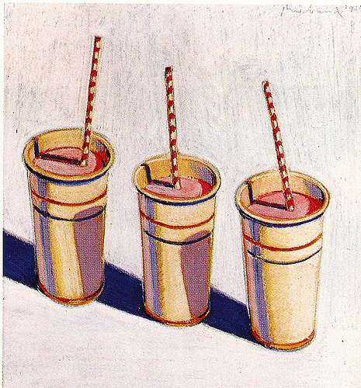
Does Thiebaud use shapes or forms?
What is the difference between a shape and a form?
What forms can you identify in these artworks?

Slide 6
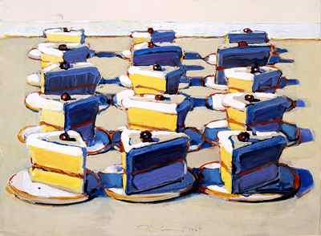
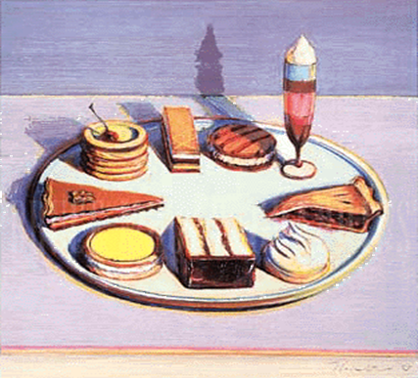
Does Thiebaud use value?
Can you point out where you see value in each artwork?
What is value?

Slide 7
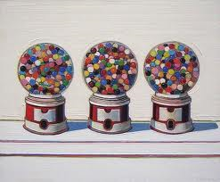
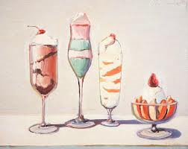
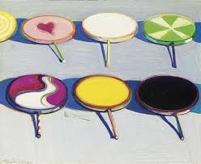
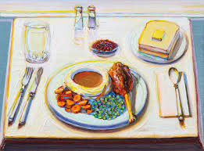
More Wayne Thiebaud Artworks

Slide 8
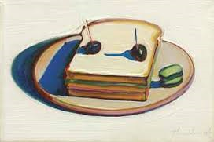
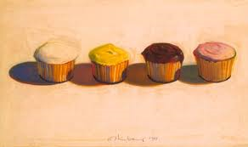
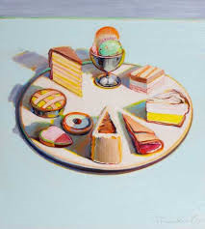
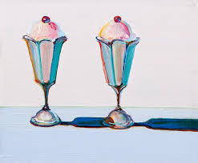
More Wayne Thiebaud Artworks

Slide 9
